Slide 1
Programming HIVE

Slide 2

Hive in Hadoop Ecosystem
Hive is a data warehouse system that is used to query and analyze large datasets stored in the HDFS. Hive uses a query language called HiveQL, which is similar to SQL.

Slide 3
Hadoop can be run in three different runtime modes, each designed for different use cases, environments, and scales of deployment.
Local Mode (Standalone Mode):
Purpose:
Used for testing and debugging small jobs on a local machine.
Characteristics: Hadoop runs as a single process on a local filesystem.
The entire MapReduce job (including both Map and Reduce tasks) runs within the same JVM process. There is no actual distributed system, so HDFS is not involved; instead, the local filesystem is used.
Example: When running Hive queries in local mode, Hive runs the job entirely on the local machine, reading files from the local filesystem.

Slide 4
Pseudo-distributed Mode:
Purpose:
Simulates a distributed environment on a single machine to help developers replicate the behavior of an actual cluster while testing.
Characteristics:
All the Hadoop services (e.g., JobTracker, NameNode, DataNode) are run as separate processes on the same machine.Filesystem references default to HDFS, and jobs are managed by the JobTracker just as in a fully distributed cluster.
However, replication of HDFS blocks is limited to one copy, since there is only one machine.
Example: When running Hive queries in pseudo-distributed mode, Hive interacts with the HDFS and MapReduce framework in a way that mimics a real cluster, but everything happens on a single machine.

Slide 5
Distributed Mode:
Purpose:
The standard production mode for running Hadoop across multiple machines in a real cluster.
Characteristics:
Files are stored in HDFS, with replication and distribution across multiple nodes.Map and Reduce tasks are distributed across nodes, and jobs are managed by the JobTracker, with individual tasks running as separate processes.
Example: In distributed mode, Hive queries rely on HDFS and the Hadoop framework for data storage and job management, distributing tasks across multiple machines in the cluster.

Slide 6
What is inside Hive :
The core of a Hive binary distribution consists of three main parts:
Java Code (JAR Files): Holds executable scripts, including the one for launching the Hive Command-Line Interface (CLI). The CLI is the most common way to interact with Hive, allowing users to execute Hive queries either interactively or by running scripts.
Executable Scripts: including the one for launching the Hive Command-Line Interface (CLI). The CLI is the most common way to interact with Hive, allowing users to execute Hive queries either interactively or by running scripts.
Apart from the CLI, Hive also includes other services, such as:
Thrift Service: Enables remote access from other processes, allowing communication via JDBC and ODBC.
Web Interface (HWI): Provides a simple way to access Hive remotely via a web interface.
Metastore: Hive requires a metastore to store table schemas and metadata.
Hive includes a conf directory, which contains configuration files controlling the system’s behavior.

Slide 7
Starting Hive CLI:
The CLI is launched using the command $HIVE_HOME/bin/hive.
The Hive CLI will print a message indicating where it stores logs, such as /tmp/myname/hive_job_log....

Slide 8
Basic Hive Commands:
The Hive prompt (hive>) appears.
Create a Table:
hive> CREATE TABLE x (a INT);
This creates a simple table x with one column a of type integer (INT).
hive> SELECT * FROM x;
This selects and displays all data from table x. Since the table is empty at this point, no data is returned.

Slide 9
Multi-Line Query:
hive> SELECT *
> FROM x;
You can spread commands across multiple lines, with the secondary prompt (>) indicating continuation.
Drop the Table:
hive> DROP TABLE x;
This deletes the table x.

Slide 10
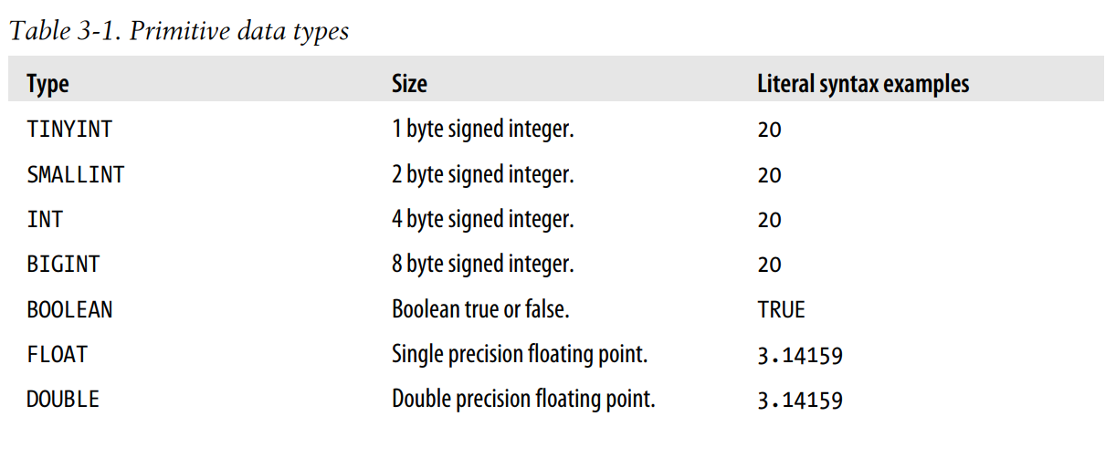
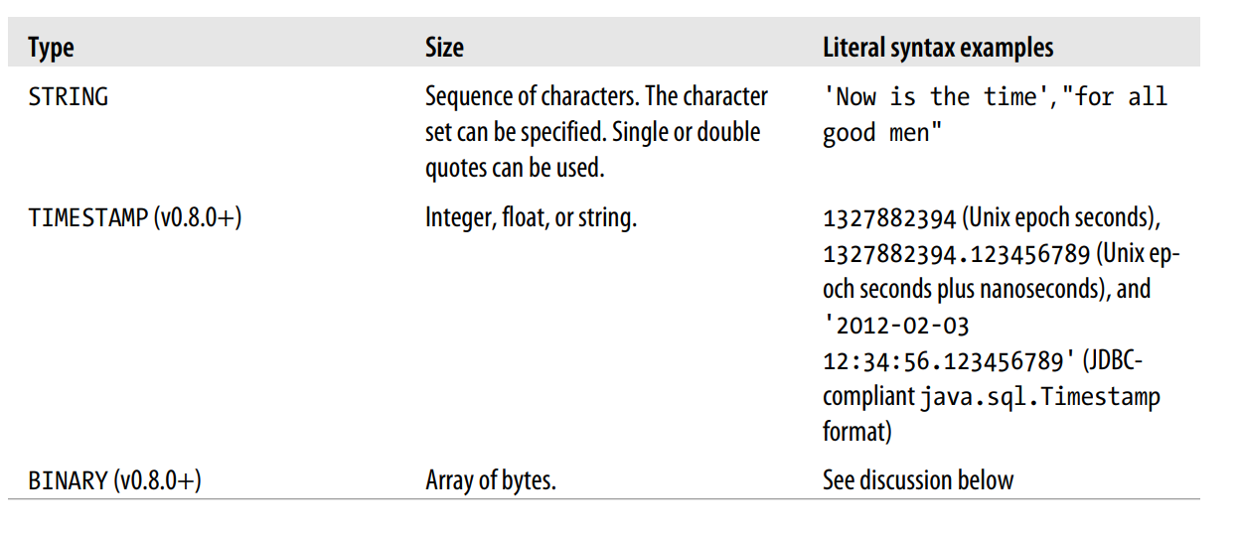
Primitive Data Types
Hive supports several sizes of
Integer
floating-point types
a Boolean type
character strings of arbitrary length.
Hive v0.8.0 added types for timestamps and binary fields.
The BINARY type is similar to the VARBINARY type found in many relational databases.
Notes:
It’s not like a BLOB type, since BINARY columns are stored within the record, not separately like BLOBs. BINARy. Note that you don’t need BINARY if your goal is to ignore the tail end of each record.
If a table schema specifies three columns and the data files contain five values for each
record, the last two will be ignored by Hive

Slide 11
Type Casting
Hive will implicitly cast any integer to the larger of the two integer types, cast FLOAT to DOUBLE, and cast any integer value to DOUBLE, as needed.
cast(s AS INT)

Slide 12
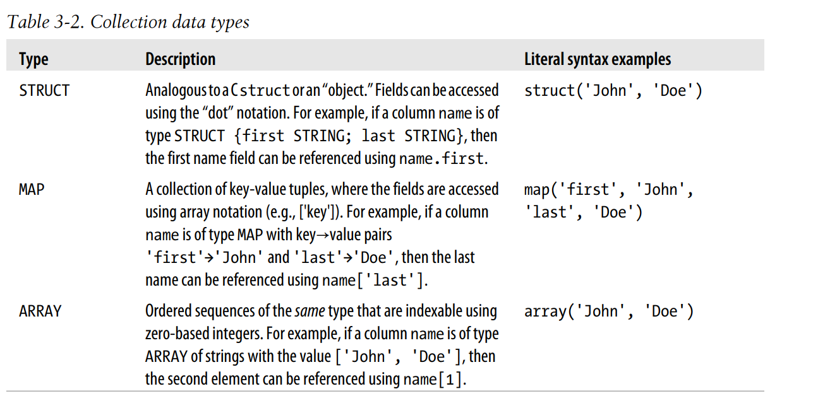
Collection Data Types
Hive supports columns that are structs, maps, and arrays.

Slide 13
CREATE TABLE employees (
name STRING,
salary FLOAT,
subordinates ARRAY<STRING>,
deductions MAP<STRING, FLOAT>,
address STRUCT<street:STRING, city:STRING, state:STRING, zip:INT>);

Slide 14
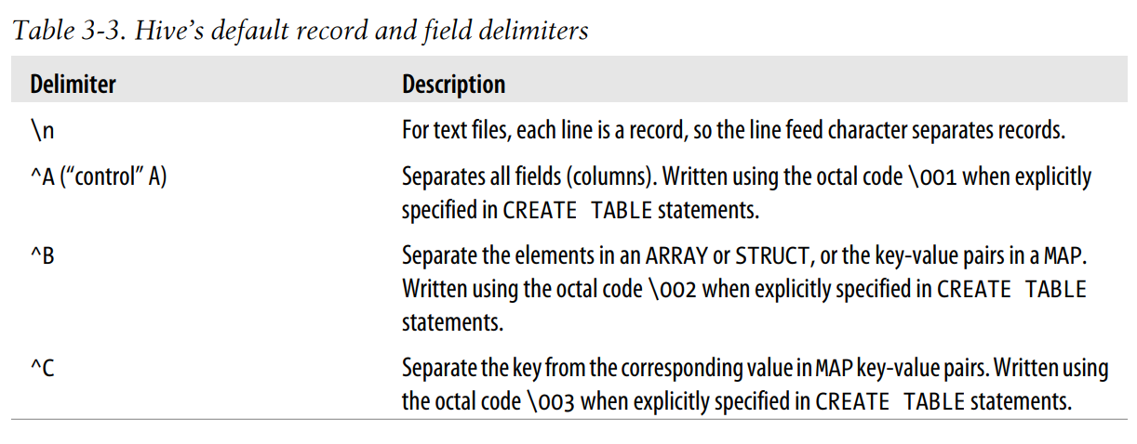
Text File Encoding of Data Values

Slide 15
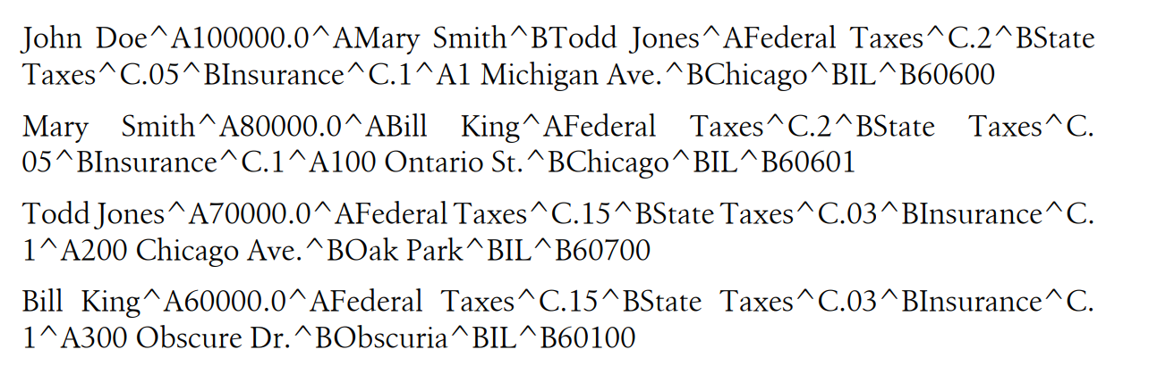
• John Doe is the name.
• 100000.0 is the salary.
• Mary Smith^BTodd Jones are the subordinates “Mary Smith” and “Todd Jones.”
• Federal Taxes^C.2^BState Taxes^C.05^BInsurance^C.1 are the deductions, where
20% is deducted for “Federal Taxes,” 5% is deducted for “State Taxes,” and 10%
is deducted for “Insurance.”
• 1 Michigan Ave.^BChicago^BIL^B60600 is the address, “1 Michigan Ave., Chicago,
60600.”

Slide 16
CREATE TABLE employees (
name STRING,
salary FLOAT,
subordinates ARRAY<STRING>,
deductions MAP<STRING, FLOAT>,
address STRUCT<street:STRING, city:STRING, state:STRING, zip:INT>
)
ROW FORMAT DELIMITED
FIELDS TERMINATED BY '\001'
COLLECTION ITEMS TERMINATED BY '\002'
MAP KEYS TERMINATED BY '\003'
LINES TERMINATED BY '\n'
STORED AS TEXTFILE;

Slide 17
The traditional database is a Gatekeeper. Why?
Total control over the storage.
Can enforce the schema as data is WRITTEN.
Schema on write.
Hive has no such control over the underlying storage.
There are many ways to create, modify, and even damage the data that Hive will query.
Hive can only enforce queries on read.
Schema on Read.

Slide 18
Databases in Hive
Catalog or namespace of tables.
They are very useful for larger clusters with multiple teams and users, as a way of avoiding table name collisions.
If you don’t specify a database, the default database is used.
Simplest syntax for creating a database:
hive> CREATE DATABASE financials;
Hive will throw an error if financials already exists.
hive> CREATE DATABASE IF NOT EXISTS financials;

Slide 19
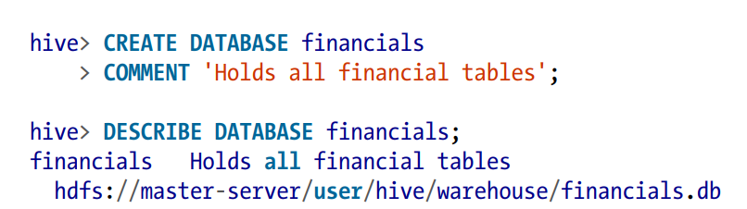
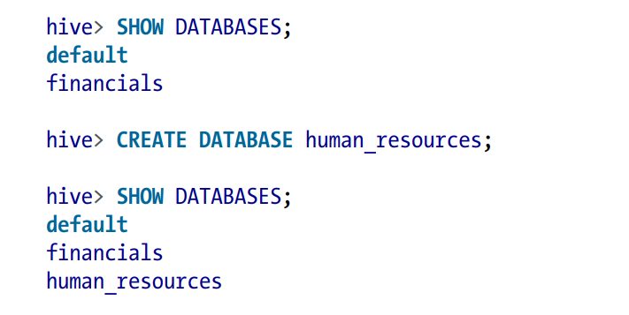
hive> SHOW DATABASES LIKE 'h.*';
human_resources

Slide 20
The USE command sets a database as your working database, analogous to changing working directories in a filesystem:
hive> USE financials
hive> SHOW TABLES;
hive> DROP DATABASE IF EXISTS financials;
Hive won’t permit you to drop a database if it contains tables.
You can either drop the tables first or append the CASCADE keyword to the command, which will cause the Hive to drop the tables in the database first:
hive> DROP DATABASE IF EXISTS financials CASCADE;

Slide 21
Alter Database
You can set key-value pairs in the DBPROPERTIES associated with a database using the ALTER DATABASE command.
No other metadata about the database can be changed, including its name and directory location:
hive> ALTER DATABASE financials SET DBPROPERTIES ('edited-by' = 'Joe Dba');
There is no way to delete or “unset” a DBPROPERTY

Slide 22
Creating Tables
The CREATE TABLE statement follows SQL conventions,
CREATE TABLE IF NOT EXISTS mydb.employees (
name STRING COMMENT 'Employee name',
salary FLOAT COMMENT 'Employee salary',
subordinates ARRAY<STRING> COMMENT 'Names of subordinates',
deductions MAP<STRING, FLOAT>
COMMENT 'Keys are deductions names, values are percentages',
address STRUCT<street:STRING, city:STRING, state:STRING, zip:INT>
COMMENT 'Home address')
COMMENT 'Description of the table'
TBLPROPERTIES ('creator'='me', 'created_at'='2012-01-02 10:00:00', ...)
LOCATION '/user/hive/warehouse/mydb.db/employees';

Slide 23
Hive automatically adds two table properties: last_modified_by holds the username of the last user to modify the table, and last_modified_time holds the epoch time in seconds of that modification.

Slide 24

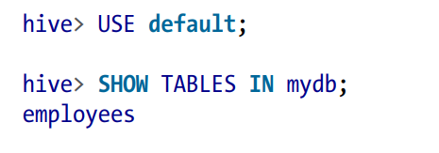
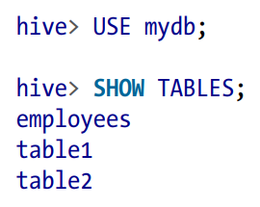
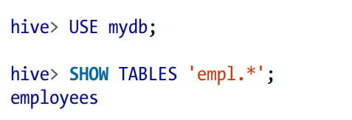

Slide 25
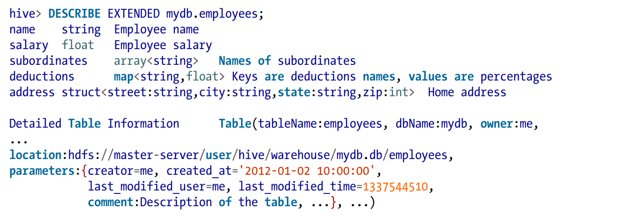
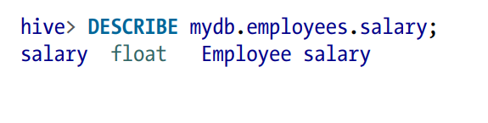

Slide 26
Managed Tables
Managed tables (or internal tables) are tables where Hive manages both the metadata and the data itself.
By default, data for managed tables is stored in a subdirectory under the path specified by hive.metastore.warehouse.dir (typically /user/hive/warehouse).
Hive controls the lifecycle of the data. If you drop a managed table, Hive will delete both the table metadata and the data itself.
While managed tables are convenient for data that is primarily accessed within Hive, they are less suitable for data that needs to be shared with other tools (like Pig or Spark)

Slide 27
External Tables
External tables are tables that point to data stored outside of Hive's control. Hive does not manage the data.
When you create an external table, you specify the location of the data (e.g., in HDFS). This is done using the LOCATION clause in the CREATE EXTERNAL TABLE statement.
Dropping an external table removes only the table metadata; the actual data remains intact, allowing multiple tools to access it without Hive taking ownership.
External tables are ideal when you have data that is shared across different tools or systems.

Slide 28
Key Differences
Ownership:
Managed Tables: Hive owns the data.
External Tables: User owns the data; Hive just points to it.
Data Deletion:
Managed Tables: Data is deleted when the table is dropped.
External Tables: Data remains when the table is dropped.

Slide 29
Checking Table Type
CREATE EXTERNAL TABLE IF NOT EXISTS stocks (
exchange STRING,
symbol STRING,
ymd STRING,
price_open FLOAT,
price_high FLOAT,
price_low FLOAT,
price_close FLOAT,
volume INT,
price_adj_close FLOAT)
ROW FORMAT DELIMITED FIELDS TERMINATED BY ','
LOCATION '/data/stocks';
DESCRIBE EXTENDED tablename
For managed tables: tableType: MANAGED_TABLE
For external tables: tableType: EXTERNAL_TABLE

Slide 30
Partitioned Table
It is commonly used to distribute load horizontally and to place data physically closer to its most frequent users.
In Hive, we utilize partitioned tables, which provide significant performance advantages and allow for logical organization of data, such as a hierarchical structure.
Consider an employees table within a large multinational corporation where HR frequently queries data filtered by country or first-level subdivisions—like states in the US or provinces in Canada.

Slide 31
CREATE TABLE employees (
name STRING,
salary FLOAT,
subordinates ARRAY<STRING>,
deductions MAP<STRING, FLOAT>,
address STRUCT<street:STRING, city:STRING, state:STRING, zip:INT>
)
PARTITIONED BY (country STRING, state STRING);
When we create this table in the mydb database, Hive structures the data storage by creating subdirectories that reflect the partitioning scheme. For example, the data may be organized as follows:
.../employees/country=CA/state=AB
.../employees/country=CA/state=BC
.../employees/country=US/state=AL
.../employees/country=US/state=AK
Once established, the partition keys (country and state) function like regular columns. Users querying the table do not need to differentiate between partitions and standard columns, except when optimizing query performance.

Slide 32
SELECT * FROM employees
WHERE country = 'US' AND state = 'IL';
Since the country and state values are encoded in the directory names, there’s no need to include them in the data files, saving space and simplifying the schema.

Slide 33
The primary advantage of partitioning is improved query speed.
In the previous example, querying for employees in Illinois only requires scanning one directory, significantly reducing the amount of data processed.
For large datasets, this partitioning can lead to substantial performance gains, particularly when the partitioning aligns with common filtering criteria, like geographical locations or time periods.

Slide 34
If a query needs to access all partitions, it can initiate a large MapReduce job, especially if the dataset is extensive.
To mitigate this, it’s advisable to enable “strict” mode in Hive, which requires that all queries on partitioned tables include a WHERE clause that filters on the partitions.
hive> set hive.mapred.mode=strict;
To check existing partitions, you can use:
hive> SHOW PARTITIONS employees;
For specific partition values, you can refine the command:
hive>SHOW PARTITIONS employees PARTITION(country='US');

Slide 35
External Tables and Partitioning
In Hive, an external table allows you to manage data stored outside the Hive warehouse directory. This means you can share data between Hive and other tools without moving it. The data is not deleted if you drop the table, which makes external tables useful for scenarios like logging, where the data needs to persist.
Partitioning is a technique to divide large datasets into smaller, manageable parts, improving query performance.

Slide 36
Logfile Analysis Example
Log messages typically contain structured information .
Timestamps
severity levels (e.g., ERROR, WARNING)
additional context (server name, process ID, and message content)
ETL Process:The Extract, Transform, Load (ETL) process ingests these log files and transforms them into a tab-delimited format.
Decomposing the Timestamp: Breaking down the timestamp into year, month, and day, which allows for efficient partitioning.
Creating an hms Field: Storing the hour, minute, and second components separately can facilitate time-based queries.
Data Types: Choosing smaller integer types for certain fields (like year, month, day) helps save space.

Slide 37
CREATE EXTERNAL TABLE IF NOT EXISTS log_messages (
hms INT,
severity STRING,
server STRING,
process_id INT,
message STRING
)
PARTITIONED BY (year INT, month INT, day INT)
ROW FORMAT DELIMITED FIELDS TERMINATED BY '\t';
Table Name: log_messages—holds all the log data.
Columns:
hms: Stores the hour, minute, and second as an integer.
severity: The severity level of the log message.
server: The server that generated the log.
process_id: Identifies the process that logged the message.
message: The actual log message content.
Partitioning: By year, month, and day, which allows for efficient querying based on time.
Row Format: Specifies that fields are tab-delimited.

Slide 38
when we created the non partitioned external stocks table, a LOCATION …clause was required. It isn’t used for external partitioned tables.
Instead, an ALTER TABLE statement is used to add each partition separately. It must specify a value for each partition key, the year, month, and day.
Example :
where we add a partition for January 2 nd, 2012:
ALTER TABLE log_messages ADD PARTITION(year = 2012, month = 1, day = 2) LOCATION 'hdfs://master_server/data/log_messages/2012/01/02';

Slide 39
Dropping Tables
DROP TABLE IF EXISTS employees;
The IF EXISTS keywords are optional. If not used and the table doesn’t exist, Hive returns an error.
For managed tables, the table metadata and data are deleted.
For external tables, the metadata is deleted but the data is not.

Slide 40
Alter Table
Most table properties can be altered with ALTER TABLE statements, which change metadata about the table but not the data itself.
These statements can be used to fix mistakes in schema, move partition locations and do other operations.

Slide 41
Renaming a Table
Use this statement to rename the table log_messages to logmsgs:
ALTER TABLE log_messages RENAME TO logmsgs;

Slide 42
Adding, Modifying, and Dropping a Table Partition :
ALTER TABLE table ADD PARTITION … is used to add a new partition to a table .
ALTER TABLE log_messages ADD IF NOT EXISTS PARTITION (year = 2011, month = 1, day = 1) LOCATION '/logs/2011/01/01'
PARTITION (year = 2011, month = 1, day = 2) LOCATION '/logs/2011/01/02'
PARTITION (year = 2011, month = 1, day = 3) LOCATION '/logs/2011/01/03' ...;

Slide 43
Finally, you can drop a partition:
ALTER TABLE log_messages DROP IF EXISTS PARTITION(year = 2011, month = 12, day = 2);

Slide 44
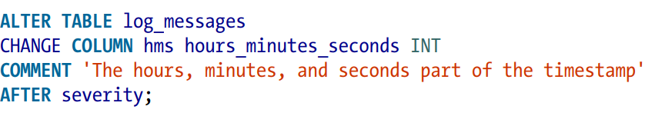
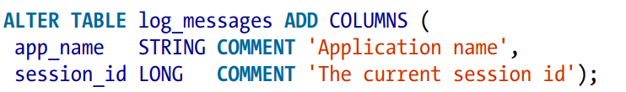
Changing Columns
If you want to move the column to the first position, use FIRST instead of AFTER other_column.
Adding Columns
If any of the new columns are in the wrong position, use an ALTER COLUMN table CHANGE COLUMN statement for each one to move it to the correct position.

Slide 45
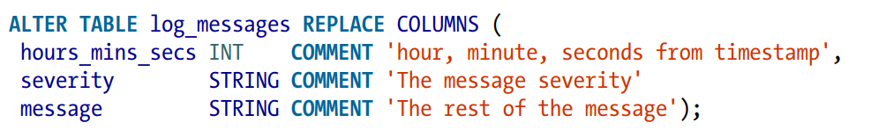
Deleting or Replacing Columns
The following example removes all the existing columns and replaces them with the new columns specified:
This statement effectively renames the original hms column and removes the server and process_id columns from the original schema definition.
As for all ALTER statements,only the table metadata is changed.

Slide 46
Alter Table Properties
You can add additional table properties or modify existing properties, but not remove them:

Slide 47
Create an external table schema definition that specifies the text format, loads data from students.csv in /user/ andrena.

Slide 48
CREATE EXTERNAL TABLE IF NOT EXISTS names_text
( student_ID INT,
FirstName STRING,
LastName STRING,
year STRING,
Major STRING) COMMENT 'Student Names'
ROW FORMAT DELIMITED FIELDS TERMINATED BY ',' STORED AS TEXTFILE LOCATION '/user/andrena';

Slide 49
Create the schema for a managed table

Slide 50
CREATE TABLE IF NOT EXISTS Names
( student_ID INT,
FirstName STRING,
LastName STRING,
year STRING,
Major STRING) COMMENT 'Student Names';

Slide 51
Data Manipulation
Hive has no row-level insert, update, and delete operations.
To use one of the “bulk” load operations.
You can just write files in the correct directories by other means.
LOAD DATA LOCAL INPATH '${env:HOME}/california-employees'
OVERWRITE INTO TABLE employees
PARTITION (country = 'US', state = 'CA');
If the LOCAL keyword is used, the path is assumed to be in the local filesystem. The data is copied into the final location.
If LOCAL is omitted, the path is assumed to be in the distributed filesystem. In this case, the data is moved from the path to the final location.
The PARTITION clause is required if the table is partitioned and you must specify a value for each partition key.
In the example, the data will now exist in the following directory: hdfs://master_server/user/hive/warehouse/mydb.db/employees/country=US/state=CA

Slide 52
Inserting Data into Tables from Queries
The INSERT statement lets you load data into a table from a query.
CREATE TABLE employees (
name STRING,
salary FLOAT,
subordinates ARRAY<STRING>,
deductions MAP<STRING, FLOAT>,
address STRUCT<street:STRING, city:STRING, state:STRING, zip:INT>
)
PARTITIONED BY (country STRING, state STRING);

Slide 53
INSERT OVERWRITE TABLE employees
PARTITION (country = 'US', state = 'OR')
SELECT * FROM staged_employees se
WHERE se.cnty = 'US' AND se.st = 'OR';
This option replaces any existing data in the specified partition.
If you drop OVERWRITE or replace it with INTO, Hive appends the new data instead.

Slide 54
If staged_employees is large, running 65 separate INSERT statements for each state means scanning the data 65 times.
To optimize this, Hive offers a different syntax:
FROM staged_employees se
INSERT OVERWRITE TABLE employees
PARTITION (country = 'US', state = 'OR')
SELECT * WHERE se.cnty = 'US' AND se.st = 'OR';
INSERT OVERWRITE TABLE employees
PARTITION (country = 'US', state = 'CA')
SELECT * WHERE se.cnty = 'US' AND se.st = 'CA';
INSERT OVERWRITE TABLE employees
PARTITION (country = 'US', state = 'IL')
SELECT * WHERE se.cnty = 'US' AND se.st = 'IL';

Slide 55
Dynamic Partition Inserts
INSERT OVERWRITE TABLE employees PARTITION (country, state)
SELECT ..., se.cnty, se.st FROM staged_employees se;
Partitioning helps in organizing data in a way that improves query performance by dividing it into manageable segments based on certain keys—in this case, country and state.
The SELECT statement pulls data from staged_employees, specifically selecting the columns that will populate the main employees table.
Hive relies on the order of the columns in the SELECT clause to determine which values go into the partition columns. Here, se.cnty and se.st correspond to country and state, respectively, based solely on their position in the output.
Because it highlights that the column names in the source (staged_employees) do not need to match the names in the destination (employees). Instead, Hive uses their positions to ascertain which values belong where.

Slide 56
You can also mix dynamic and static partitions.
This variation of the previous query specifies a static value for the country (US) and a dynamic value for the state:
INSERT OVERWRITE TABLE employees
PARTITION (country = 'US', state)
SELECT ..., se.cnty, se.st
FROM staged_employees se
WHERE se.cnty = 'US';
The static partition keys must come before the dynamic partition keys.

Slide 57
Creating Tables and Loading Them in One Query
CREATE TABLE ca_employees
AS SELECT name, salary, address FROM employees
WHERE se.state = 'CA';
This table contains just the name, salary, and address columns from the employee table records for employees in California. The schema for the new table is taken from the SELECT clause.

Slide 58
Dynamic partitioning is not enabled by default.
SET hive.exec.dynamic.partition=true;
This command enables dynamic partitioning in Hive.
SET hive.exec.dynamic.partition.mode=nonstrict;
It allows for the creation of new partitions during an insert operation, without the need to have them predefined.
SET hive.exec.max.dynamic.partitions.pernode=1000;
sets a limit on the number of dynamic partitions that can be created on each node in the cluster during a single insert operation.

Slide 59
INSERT OVERWRITE TABLE employees
PARTITION (country, state)
SELECT ..., se.cty, se.st
FROM staged_employees se;
This command performs an INSERT OVERWRITE operation on the employees table, which is partitioned by country and state.
The data is selected from the staged_employees table.
The se.cty and se.st fields in the SELECT statement specify the partition values dynamically.

Slide 60
Illustration : Imagine you have a database for managing student records, and you want to store data in a partitioned table based on country and state.
student_id | name | age | country | state
1 | Alice | 20 | USA | California
2 | Bob | 22 | USA | New York
3 | Charlie | 21 | Canada | Ontario
4 | David | 23 | USA | Claifornia
5 | Eve | 19 | Canada | Quebec

Slide 61
SET hive.exec.dynamic.partition=true;
SET hive.exec.dynamic.partition.mode=nonstrict;
SET hive.exec.max.dynamic.partitions.pernode=1000;
INSERT OVERWRITE TABLE students
PARTITION (country, state)
SELECT student_id, name, age, country, state
FROM staged_students;

Slide 62
Results Partitions in student table
Partition: country=USA, state=California:
Records:
student_id: 1, name: Alice, age: 20
student_id: 4, name: David, age: 23
Partition: country=USA, state=New York:
Records:
student_id: 2, name: Bob, age: 22
Partition: country=Canada, state=Ontario:
Records:
student_id: 3, name: Charlie, age: 21
Partition: country=Canada, state=Quebec:
Records:
student_id: 5, name: Eve, age: 19

Slide 63
Final state of students table
After executing the commands, your students table will look like this, organized into the respective partitions.
students/country=USA/state=California/
Alice, 20
David, 23
students/country=USA/state=New York/
Bob, 22
students/country=Canada/state=Ontario/
Charlie, 21
students/country=Canada/state=Quebec/
Eve, 19

Slide 64
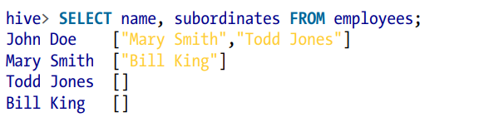
SELECT … FROM Clauses
SELECT is the projection operator in SQL.
hive> SELECT name, salary FROM employees;
hive> SELECT e.name, e.salary FROM employees e;
When you select columns that are one of the collection types, Hive uses JSON (JavaScript Object Notation) syntax for the output.

Slide 65
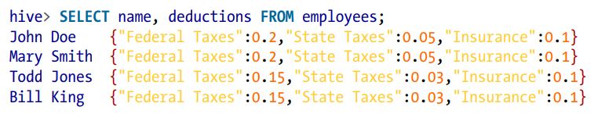
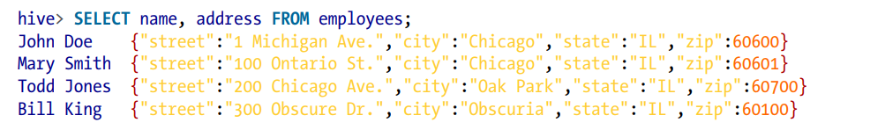

Slide 66
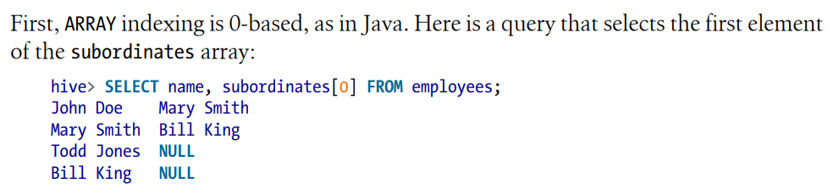

Slide 67
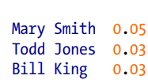
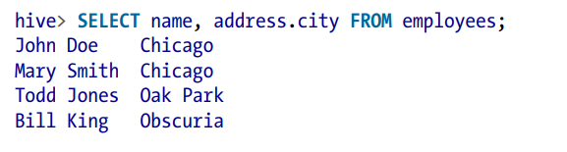

Slide 68
Specify Columns with Regular Expressions
hive> SELECT symbol, `price.*` FROM stocks;
AAPL 195.69 197.88 194.0 194.12 194.12
AAPL 192.63 196.0 190.85 195.46 195.46
AAPL 196.73 198.37 191.57 192.05 192.05
AAPL 195.17 200.2 194.42 199.23 199.23
AAPL 195.91 196.32 193.38 195.86 195.86

Slide 69
Computing with Column Values
Manipulate column values using function calls and arithmetic expressions.
hive> SELECT upper(name), salary, deductions["Federal Taxes"], > round(salary * (1 - deductions["Federal Taxes"])) FROM employees;

Slide 70
Arithmetic Operators
A + B Numbers Add A and B.
A - B Numbers Subtract B from A.
A * B Numbers Multiply A and B.
A / B Numbers Divide A with B. If the operands are integer types, the quotient of the division is returned.
A % B Numbers The remainder of dividing A with B.
A & B Numbers Bitwise AND of A and B.
A | B Numbers Bitwise OR of A and B.
A ^ B Numbers Bitwise XOR of A and B.
~A Numbers Bitwise NOT of A.

Slide 71
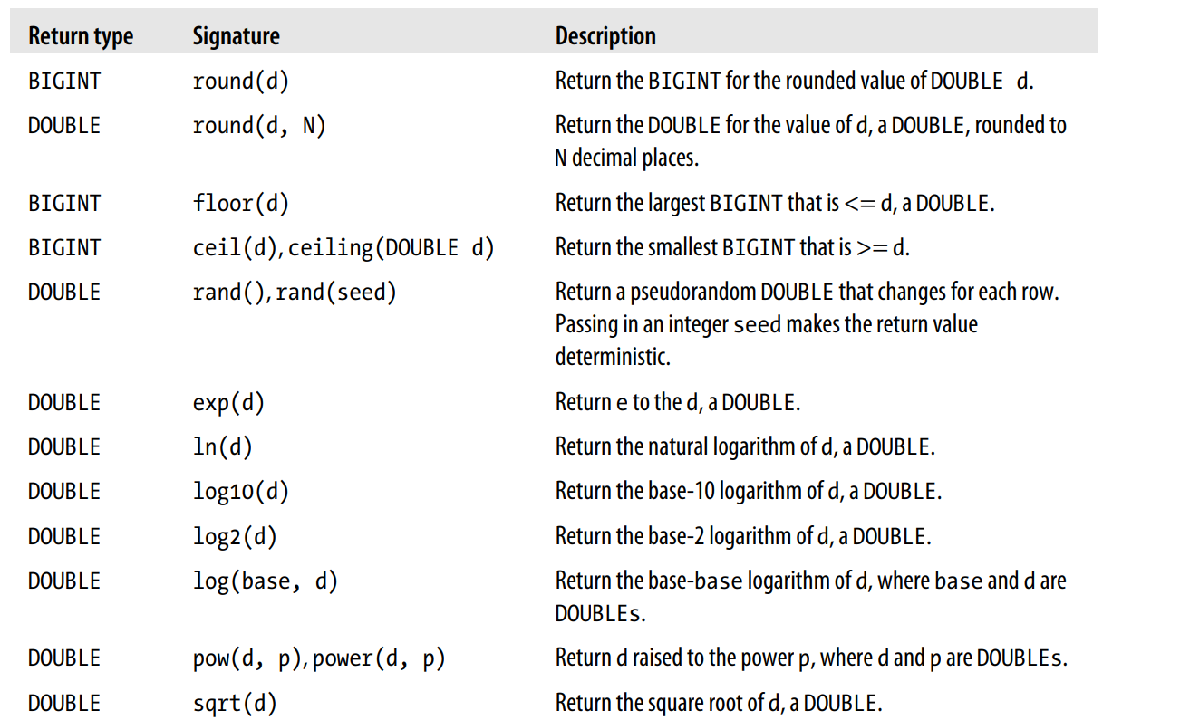
Mathematical functions

Slide 72
Aggregate functions
Returns a single value resulting from some computation over many rows
hive> SELECT count(*), avg(salary) FROM employees;
hive> SELECT count(DISTINCT ymd), count(DISTINCT volume) FROM stocks;

Slide 73
Table generating functions
SELECT parse_url_tuple(url, 'HOST', 'PATH', 'QUERY') as (host, path, query) FROM url_table;

Slide 74
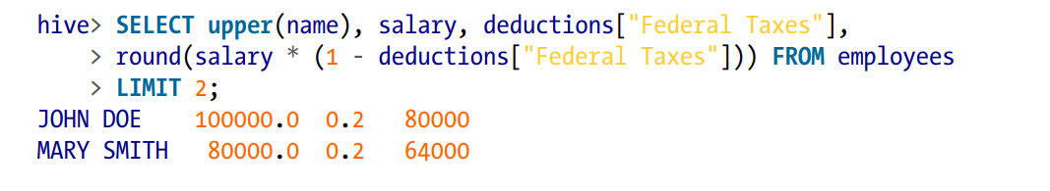
LIMIT Clause
The results of a typical query can return a large number of rows.

Slide 75
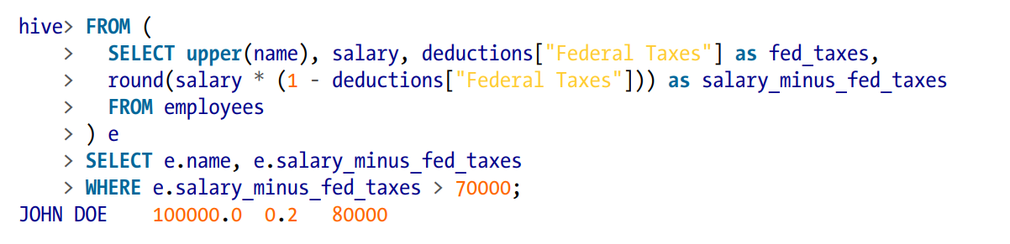
Nested SELECT Statements

Slide 76

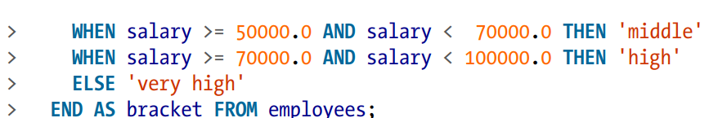
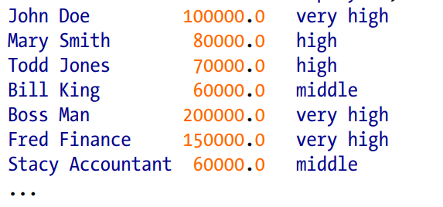
CASE … WHEN … THEN Statements
The CASE … WHEN … THEN clauses are like if statements for individual columns in query results.

Slide 77
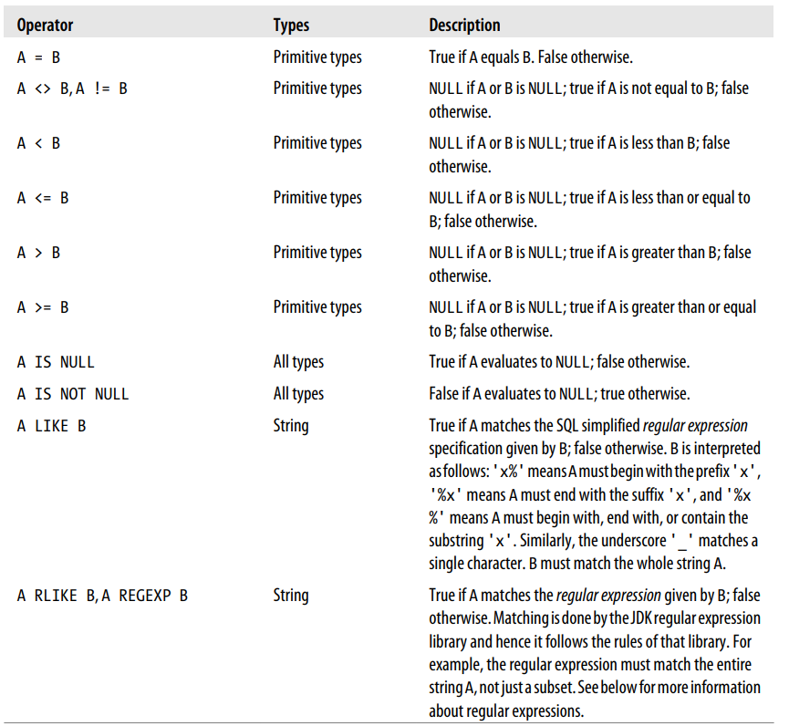
Predicate Operators

Slide 78
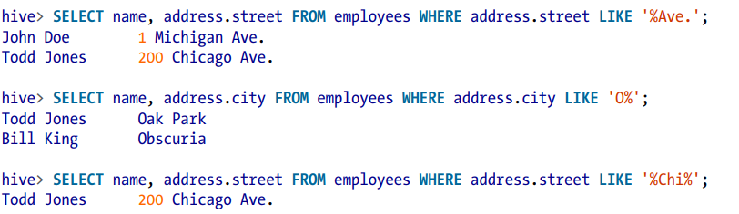
LIKE and RLIKE

Slide 79
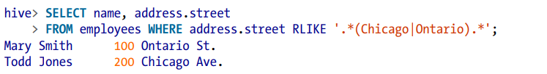

Slide 80
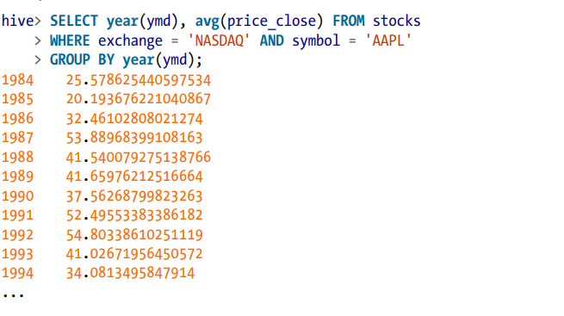
GROUP BY Clauses
The GROUP BY statement is often used in conjunction with aggregate functions to group the result set by one or more columns and then perform an aggregation over each group.

